Slide 1
NS-3 Mobility and Energy Model

Slide 2
Mobility Model
Defines how the movement of a node will change over time
Most models assume movements in a 2D plane
Different models account for different characteristics:
Randomness
Dependence on previous movement
Movement restrictions
Examples:
Random walk
Random direction
Gauss-Markov

Slide 3
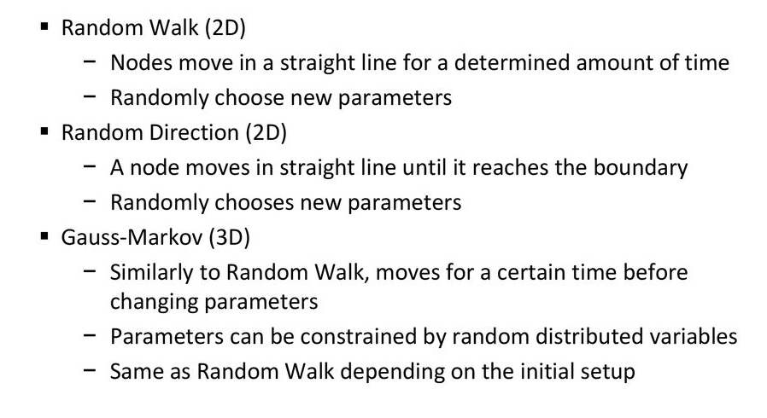
Existing Model

Slide 4
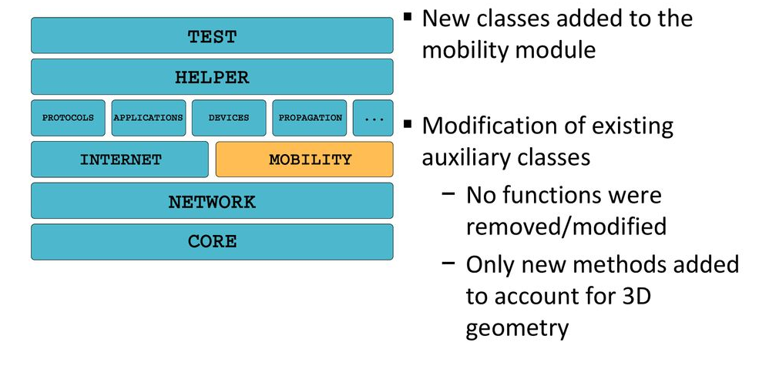
Scope of work

Slide 5
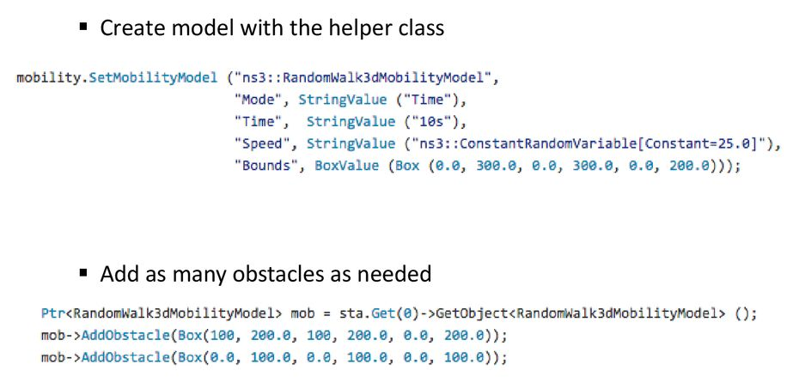
ns3:RandomWalk3dMobilityModel

Slide 6
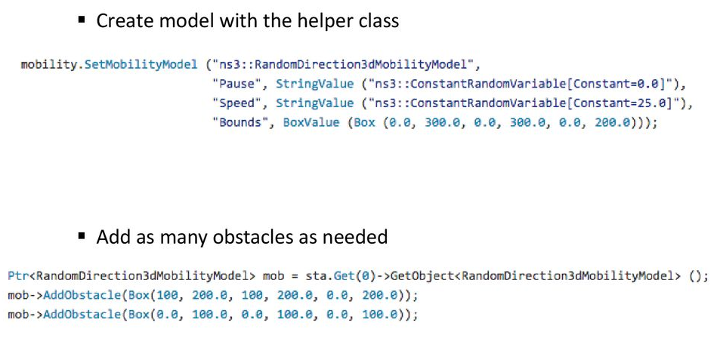
ns3:RandomDirection3dMobilityModel

Slide 7
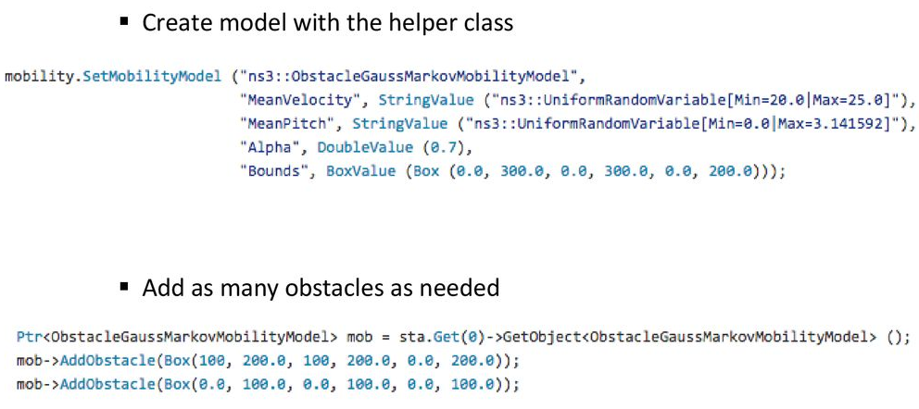
ns3:ObstacleGaussMarkovMobilityModel

Slide 8
Energy Model
Energy modeling is a key element in wireless network
Energy consumption is an important metric for evaluating the performance of wireless network protocols
Energy source model
Battery
Device Energy consumption model
Radio

Slide 9
/* create some nodes */
NodeContainer c;
c.Create(5);
/* energy source */
BasicEnergySourceHelper basicSourceHelper;
// configure energy source
basicSourceHelper.Set ("BasicEnergySourceInitialEnergyJ", DoubleValue (0.1));
// install source
EnergySourceContainer sources = basicSourceHelper.Install (c);
/* device energy model */
WifiRadioEnergyModelHelper radioEnergyHelper;
// configure radio energy model
radioEnergyHelper.Set ("TxCurrentA", DoubleValue (0.0174));
// install device model
DeviceEnergyModelContainer deviceModels = radioEnergyHelper.Install (devices, sources);

